Slide 1
Nykaa Beauty Products Analysis
Beauty skin products

Slide 2
About Me
I am from B.Sc. Maths,Statistics and Computers Background
I am Interested in visualizing and interpretation of the data it is there in data science and also visualizing can clearly shows and understanding of the data.
I have Non-IT work experience of more than 6 years.

Slide 3
Business Problem and Use case domain understanding
The business problem is to analyzing the pricing, discounts, customer reviews, and shades of beauty products from Nykaa. The goal is to derive insights that can help optimize pricing strategies, identify popular product shades, and understand how discounts impact sales and reviews.

Slide 4
Objective of the Project
Understand the distribution of prices, discounts, and reviews.
Identify patterns and relationships between pricing, discount offers, and customer reviews.
Provide actionable insights to optimize product pricing and discount strategies, as well as highlight popular product attributes like shades.

Slide 5
Web Scraping – Details (Websites, Processor you followed)
Website: Nykaa website, which features a variety of beauty products.
Process:
Used Python libraries like Beautifulsoup and requests to extract product details (Original Price, Offer Price, Discount, Reviews, and Shades).
The HTML structure was analyzed to identify the relevant tags containing the desired data fields.
Data was then cleaned and structured into a pandas DataFrame for further analysis.

Slide 6
Summary of the Data
The dataset contains key attributes for beauty products, including Brand,Product name,Original Price, Offer Price, Discount, Reviews, offer and Shades. The data provides valuable insights into how pricing strategies and product variations affect customer engagement and sales.

Slide 7
Exploratory Data Analysis:
Data Cleaning Steps
Handling Missing Values: Checked for any missing values in columns and decided whether to fill or remove them.
Data Type Correction: Ensured that columns such as prices and reviews were in the correct numerical format, while categorical variables like shades were handled as string types.

Slide 8
Data Manipulation Steps:
Feature Creation: Created new features such as discount percentage from the existing columns (Original Price and Offer Price) to facilitate deeper analysis.
Grouping and Aggregating: Grouped data based on product shades to explore how different shades impact product prices and reviews.

Slide 9
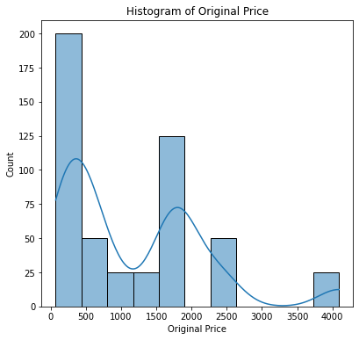
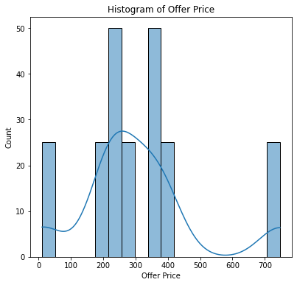
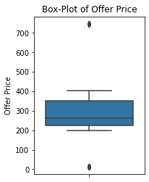
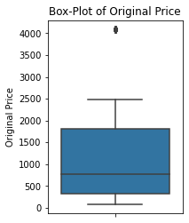
Univariate Analysis Steps:
Statistical Summary: Calculated basic statistical metrics (mean, median, standard deviation) for continuous variables such as Original Price, Offer Price, and Reviews.
Visualizations: Plotted histograms, boxplots, and bar charts to visualize the distribution of individual variables and detect patterns like skewness, outliers, and popular categories.

Slide 10
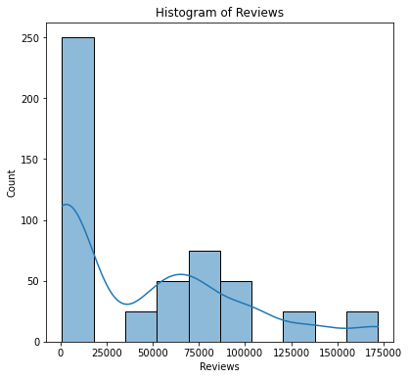
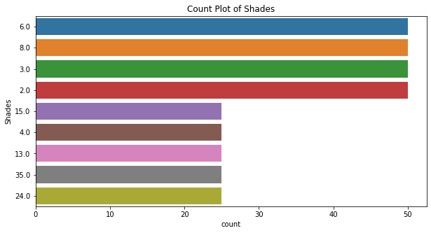
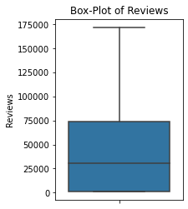
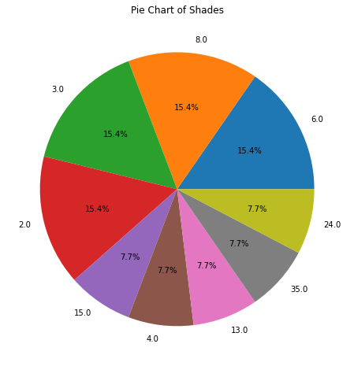
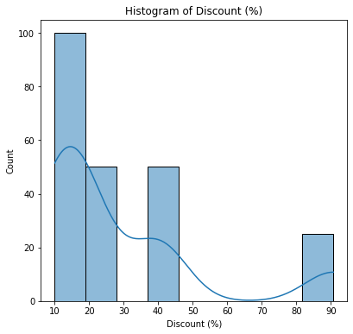
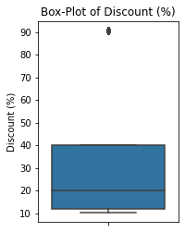

Slide 11
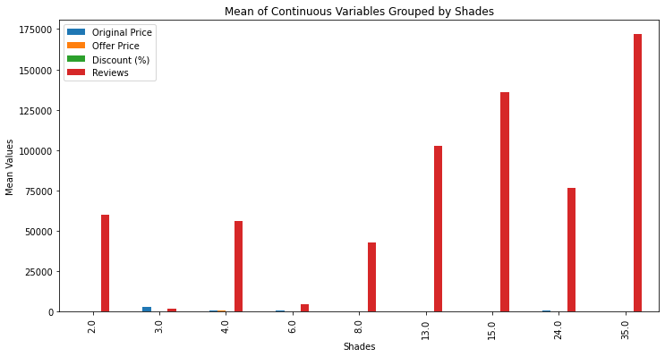
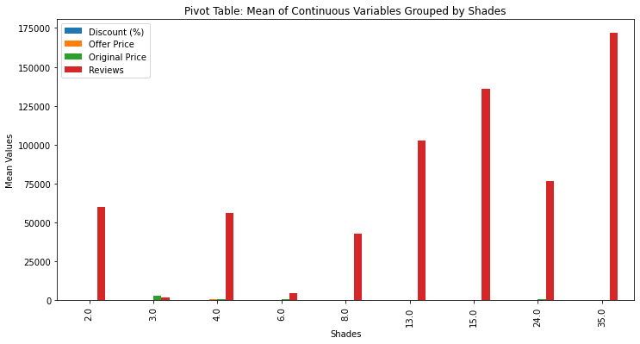
Bi-variate Analysis/Multivariate :
Correlation Analysis: Calculated the correlation between continuous variables (e.g., Original Price and Discount) to explore relationships.
Groupby and Pivot Tables: Grouped data by categorical variables (like Shades) and compared average prices, discounts, and reviews to understand how categorical factors influence continuous variables.
Crosstab Analysis: Used crosstabs to analyze relationships between categorical variables (e.g., Shades and Reviews) to detect patterns in product popularity.

Slide 12
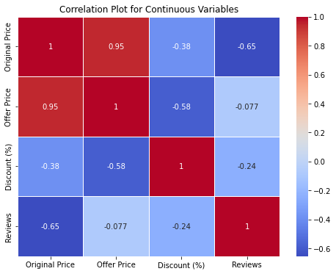
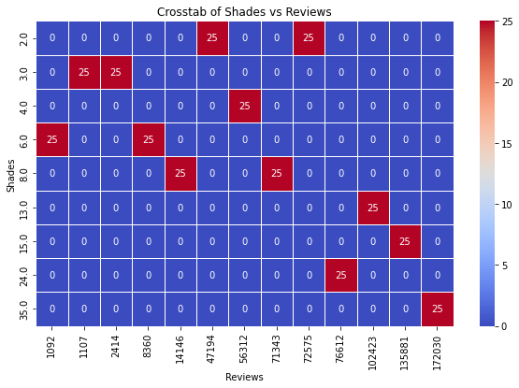

Slide 13
Key Business Question:
How can Nykaa optimize its pricing and discount strategies to maximize customer engagement and product sales, while identifying popular product attributes like shades that drive customer preferences?

Slide 14
Conclusion (Key Findings Overall):
The analysis revealed that most beauty products are priced affordably, but premium products are offered at significant discounts to attract customers.
Certain shades are more popular, driving higher customer reviews and engagement.
While discounts are commonly offered, their impact on reviews is not as significant, suggesting that other factors like brand or product quality may drive customer satisfaction.

Slide 15


Slide 16
Experience/Challenges Working on Web Scraping – Data Analysis Project:
The main challenge was handling dynamic web elements and ensuring that the scraping process was efficient. Cleaning and structuring the scraped data for analysis required extra effort due to inconsistencies in the data format across different products. However, the project provided valuable insights into working with e-commerce data for decision-making.

